Slide 1
Network Layer Internet Protocol
Sangmyung Univ., Fall 2020

Slide 2
Contents
Network Layer functions
Routing algorithms overview
IP protocol overview
IP header fields
IP address configuration (DHCP)
ICMP

Slide 3
Network layer functions
packetizing:
encapsulating the payload in a network-layer packet at the source and decapsulating the payload from the network-layer packet at the destination.
to carry a payload from the source to the destination without changing it or using it.
i.e. such as the postal office, which is responsible for delivery of packages from a sender to a receiver without changing or using the contents.
routing and forwarding
forwarding: move packets from router’s input to appropriate router output
routing: determine route taken by packets from source to dest.

Slide 4
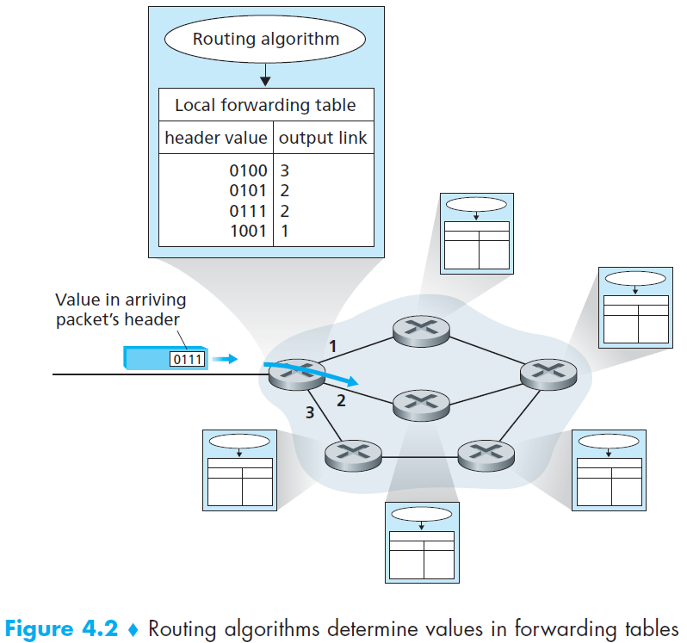
Routing & Forwarding
routing algorithm determines
end-end-path through network
forwarding table determines
local forwarding
to an output port

Slide 5
Other functions at Network layer
Connection setup
3rd important function in some network architectures:
ATM, frame relay, X.25
before packets flow, two end hosts and intervening routers establish virtual connection
routers get involved
Packet switching

Slide 6
Contents
Network Layer functions
Routing algorithms overview
IP protocol overview
IP header fields
IP address configuration (DHCP)
ICMP

Slide 7
Routing
5
c(x,x’) = cost of link (x,x’)
e.g., c(w,z) = 5
cost could always be 1, or
inversely related to bandwidth, or
related to congestion
v
3
w
2
5
u
2
1
z
3
1
2
x
y
1
cost of path (x₁, x₂, x₃,…, x_{p}) = c(x₁,x₂) + c(x₂,x₃) + … + c(x_{p-1},x_{p})
key question: what is the least-cost path between u and z ?
routing algorithm: algorithm that finds that least cost path

Slide 8
Routing algorithm classification
Q: global or decentralized information?
global:
all routers have complete topology, link cost info
“link state” algorithms
decentralized:
router knows physically-connected neighbors, link costs to neighbors
iterative process of computation, exchange of info with neighbors
“distance vector” algorithms
Q: static or dynamic?
static:
routes change slowly over time
dynamic:
routes change more quickly
periodic update
in response to link cost changes

Slide 9
1) A Link-State Routing Algorithm
Dijkstra’s algorithm
net topology & link costs are known to all nodes
accomplished via “link state broadcast”
all nodes have same info
computes least cost paths from one node (‘source”) to all other nodes
gives forwarding table for that node
iterative calculations for shortest path nodes: after k iterations, know least cost path to k destinations
u determines (u,x) to x
(u, x, y) to y
(u, v) to v .. and so on
5
v
3
w
2
5
u
2
1
z
3
1
2
x
y
1

Slide 10
2) A distance-vector algorithm
Bellman-ford equation: calculate the short path from neighbor information
node achieving minimum is the next hop in shortest path (this information will be used in forwarding table).
Neighbors say three ways to z from u:
(v, x, y, z) = 5
(x, y, z) = 3
(w, z) = 3
U knows the cost to the neighbors:
(u, v) = 2
(u, x) = 1
(u, w) = 5
5
v
3
w
2
5
u
2
1
z
3
1
2
x
y
1

Slide 11


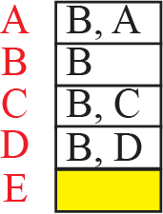


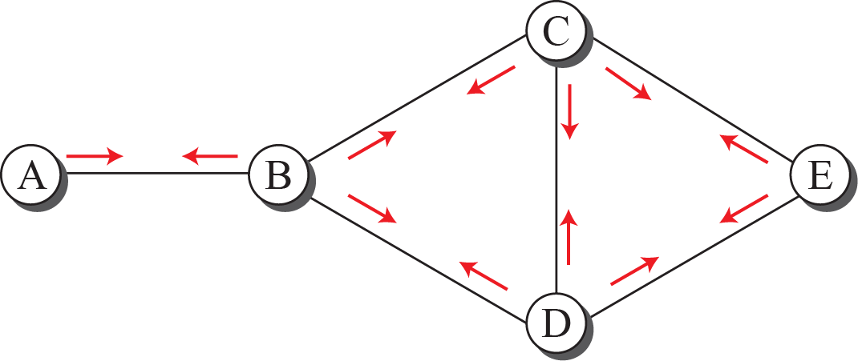


3) Path-Vector algorithm at initial state

Slide 12
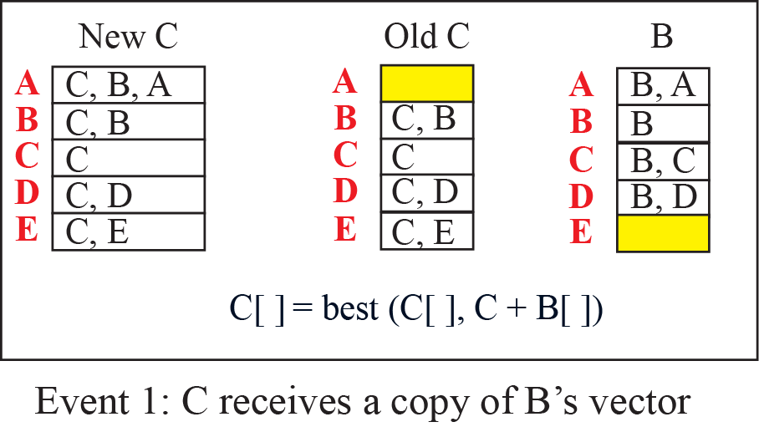
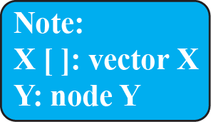
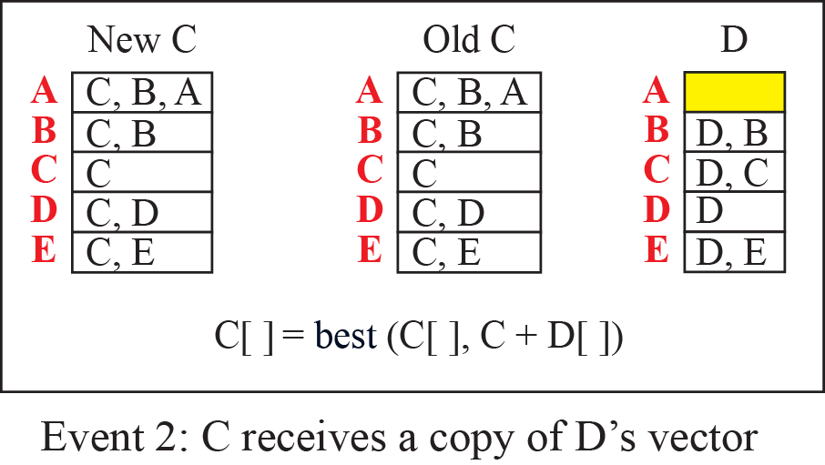
3) Path-Vector algorithm updating path vectors

Slide 13
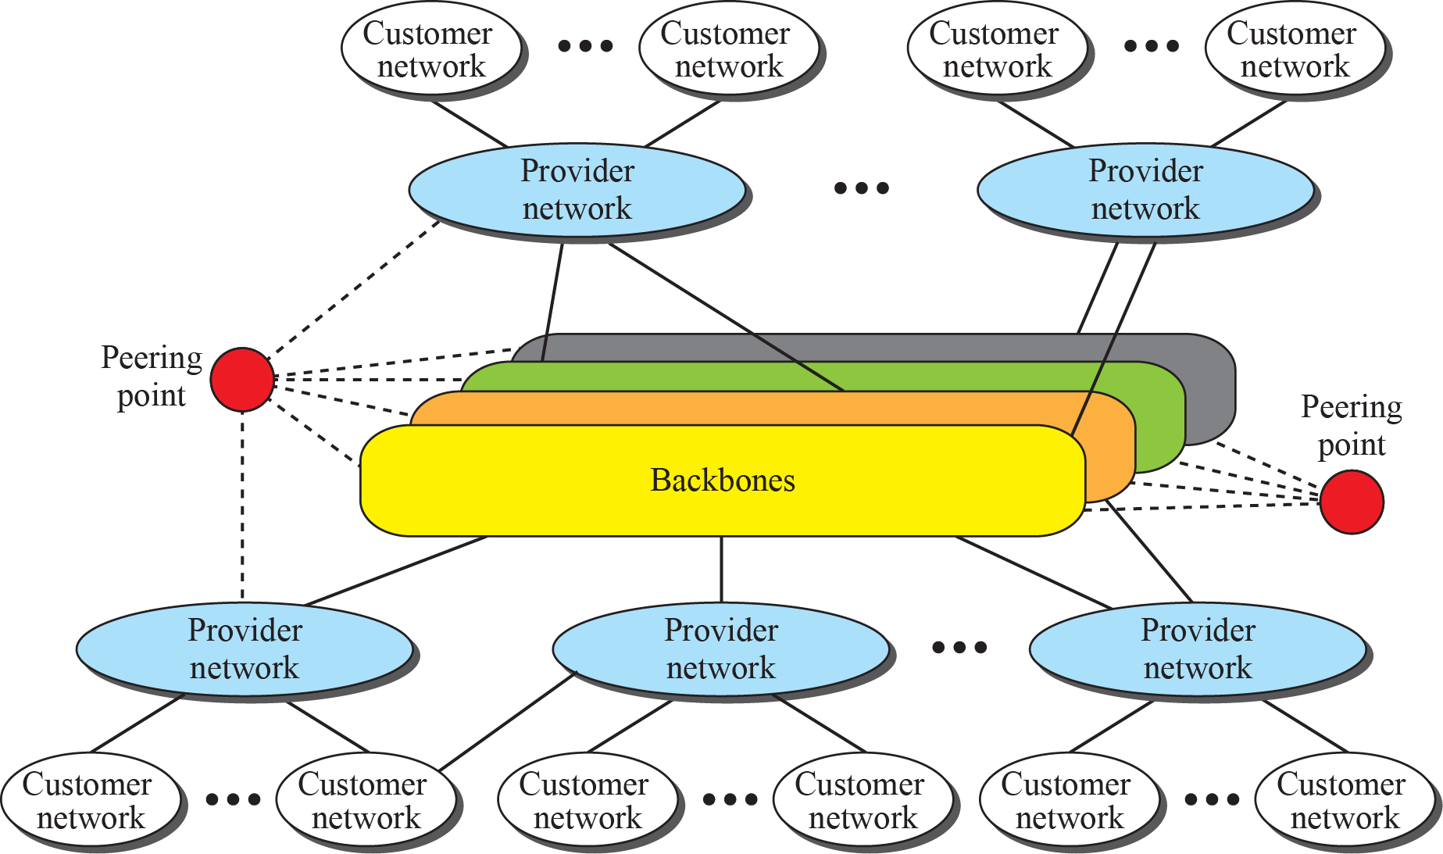
Internet structure
A single network with a single administrative entity is called an Autonomous system, or a Domain
Intra-AS routing uses 1) and 2). Inter-AS routing uses 3)

Slide 14
Contents
Network Layer functions
Routing algorithms overview
IP protocol overview
IP header fields
IP address configuration (DHCP)
ICMP

Slide 15
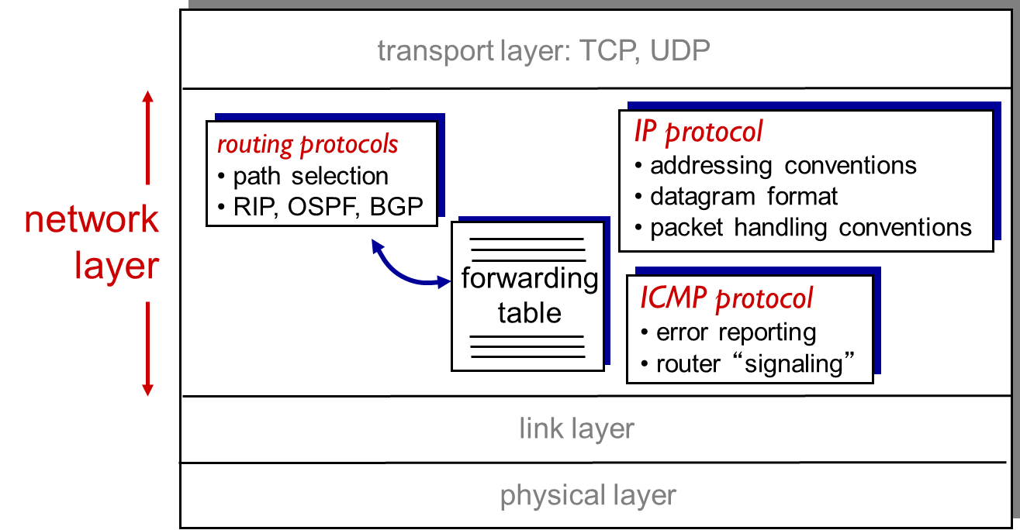
Network layer in the Internet

Slide 16
IP (Internet Protocol) : The waist of the hourglass
IP is the waist of the hourglass of the Internet protocol architecture
Multiple higher-layer protocols
Multiple lower-layer protocols
Only one protocol at the network layer.

Slide 17
IP Service
Delivery service of IP is minimal
IP provides an unreliable, connectionless, “best effort” service
Unreliable: IP does not make an attempt to recover lost packets
Connectionless: Each packet (“datagram”) is handled independently. IP is not aware that packets between hosts may be sent in a logical sequence
Best effort: IP does not make guarantees on the service (no throughput guarantee, no delay guarantee,…)
Consequences:
Higher layer protocols have to deal with losses or with duplicate packets
Packets may be delivered out-of-sequence

Slide 18
IP Service
IP supports the following services:
one-to-one (unicast)
one-to-all (broadcast)
one-to-several (multicast)
IP multicast also supports a many-to-many service.
IP multicast requires support of other protocols (IGMP, multicast routing)
unicast
broadcast
multicast

Slide 19
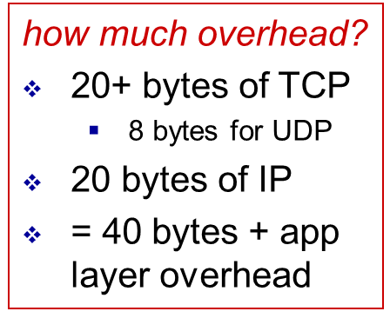
IP packet format
IP protocol version
number
32 bits
total packet
length (bytes)
header length
(bytes)
head.
len
type of
service
ver
length
for
fragmentation/
reassembly
“type” of data
flgs
fragment
offset
16-bit identifier
max number
remaining hops
(decremented at
each router)
time to
live
upper
layer
header
checksum
32 bit source IP address
upper layer protocol
to deliver payload to
32 bit destination IP address
options (if any)
e.g. timestamp,
record route
taken, specify
list of routers
to visit.
data
(variable length,
typically a TCP
or UDP segment)

Slide 20
Fields of the IP Header
Version (4 bits): current version is 4, next version is 6.
Header length (4 bits): length of IP header, in multiples of 4 bytes
DS/ECN field (1 byte)
This field was previously called as Type-of-Service (TOS) field. The role of this field has been re-defined, but is “backwards compatible” to TOS interpretation
Differentiated Service (DS) (6 bits):
Used to specify service level (currently not supported in the Internet)
Explicit Congestion Notification (ECN) (2 bits):
New feedback mechanism used by TCP (RFC3168, 2001)

Slide 21
Fields of the IP Header
Time To Live (TTL) (1 byte):
Specifies longest paths before packet is dropped
Role of TTL field: Ensure that packet is eventually dropped when a routing loop occurs
Used as follows:
Sender sets the value (e.g., 64)
Each router decrements the value by 1
When the value reaches 0, the packet is dropped

Slide 22
Fields of the IP Header
Protocol (1 byte):
Specifies the higher-layer protocol.
Used for demultiplexing to higher layers.
Header checksum (2 bytes): A simple 16-bit long checksum which is computed for the header of the packet.

Slide 23
Fields of the IP Header
Options:
Security restrictions
Record Route: each router that processes the packet adds its IP address to the header.
Timestamp: each router that processes the packet adds its IP address and time to the header.
(loose) Source Routing: specifies a list of routers that must be traversed.
(strict) Source Routing: specifies a list of the only routers that can be traversed.
Padding: Padding bytes are added to ensure that header ends on a 4-byte boundary

Slide 24
Maximum Transmission Unit
Theoretical maximum size of IP packet is 65535, but the data link layer protocol generally imposes a limit that is much smaller
Example:
Ethernet frames have a maximum payload of 1500 bytes
→ IP packets encapsulated in Ethernet frame cannot be longer than 1500 bytes
The limit on the maximum IP packet size, imposed by the data link protocol is called maximum transmission unit (MTU)
MTUs for various data link protocols:
Ethernet: 1500 FDDI: 4352
802.3: 1492 ATM AAL5: 9180
802.5: 4464 PPP: negotiated

Slide 25

IP fragmentation, reassembly
networks have different link types, different MTUs
large IP packet divided (“fragmented”) within net
one packet becomes several packets
“reassembled” only at final destination
IP header bits used to identify, order related fragments
…
fragmentation:
in: one large packet
out: 3 smaller packets
reassembly
…

Slide 26
Where is Fragmentation done?
Fragmentation can be done at the sender or at intermediate routers
The same packet can be fragmented several times.
Reassembly of original packet is only done at destination hosts

Slide 27
What’s involved in Fragmentation?
The following fields in the IP header are involved:
Identification When a packet is fragmented, the identification is the same in all fragments
Flags
DF bit is set: packet cannot be fragmented and must
be discarded if MTU is too small (Don’t Fragment)
MF bit set: This packet is part of a fragment and an
additional fragment follows this one (More Fragments)
Fragment offset Offset of the payload of the current fragment in the original packet
Total length Total length of the current fragment

Slide 28
Contents
Network Layer functions
Routing algorithms overview
IP protocol overview
IP header fields
IP address configuration (DHCP)
ICMP

Slide 29
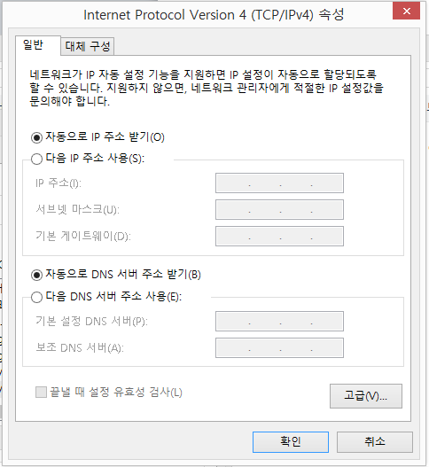
How a host gets IP addresses
Q: How does a host get IP address?
Manual: hard-coded by system admin in a file
Windows: control-panel->network->configuration->tcp/ip->properties
UNIX: /etc/rc.config
Dynamic
DHCP: Dynamic Host Configuration Protocol: dynamically get address from a server
“plug-and-play”

Slide 30
Dynamic assignment of IP addresses is desirable for several reasons:
IP addresses are assigned on-demand
Avoid manual IP configuration
Support mobility of laptops

Slide 31
DHCP: Dynamic Host Configuration Protocol
From 1993
An extension of BOOTP (Bootstrap protocol)
Sent as UDP messages (UDP Port 67 (server) and 68 (client))
Use limited broadcast address (255.255.255.255)
assigns IP address; also tells default router’s IP address, network mask
goal: allow host to dynamically obtain its IP address from network server when it joins network
can renew its lease on address in use
allows reuse of addresses
only hold address while connected
support for mobile users who want to join network
DHCP overview:
host broadcasts “DHCP discover” msg [optional]
DHCP server responds with “DHCP offer” msg [optional]
host requests IP address: “DHCP request” msg
DHCP server sends address: “DHCP ack” msg

Slide 32
Two types of Broadcast address
The local (limited) broadcast
address is 255.255.255.255
The traffic sent to that address will be sent to all the hosts on the local network
it is not a routable address, so a router would not route it anywhere.
The directed broadcast address
is sent to all hosts on a specific subnet
for example the directed broadcast address for the subnet 10.0.0.0/8 is 10.255.255.255
This address is routable, so a router would forward it to the end destination gateway if the router is configured to do so.

Slide 33


DHCP client-server scenario
DHCP
server
223.1.1.0/24
223.1.1.1
223.1.2.1
223.1.1.2
arriving DHCP
client needs
address in this
network
223.1.1.4
223.1.2.9
223.1.3.27
223.1.2.2
223.1.1.3
223.1.2.0/24
223.1.3.1
223.1.3.2
If DHCP server is not in a subnet, the router works as a DHCP relay agency
223.1.3.0/24

Slide 34


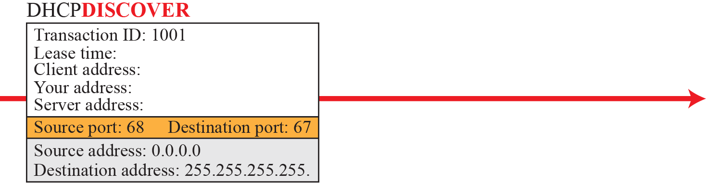
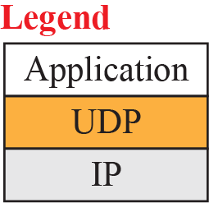
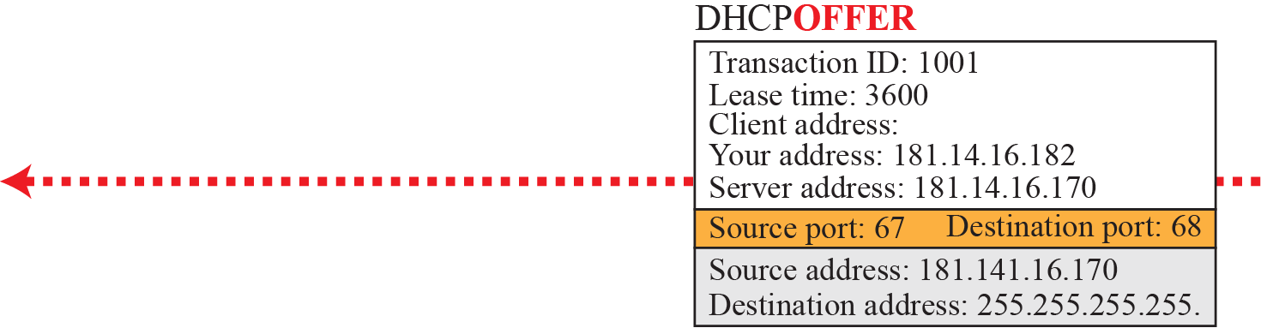
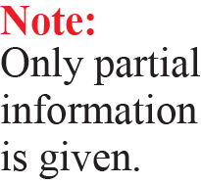
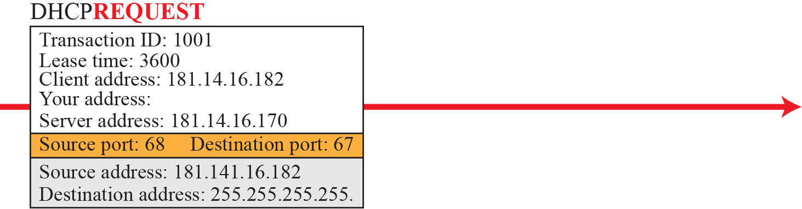
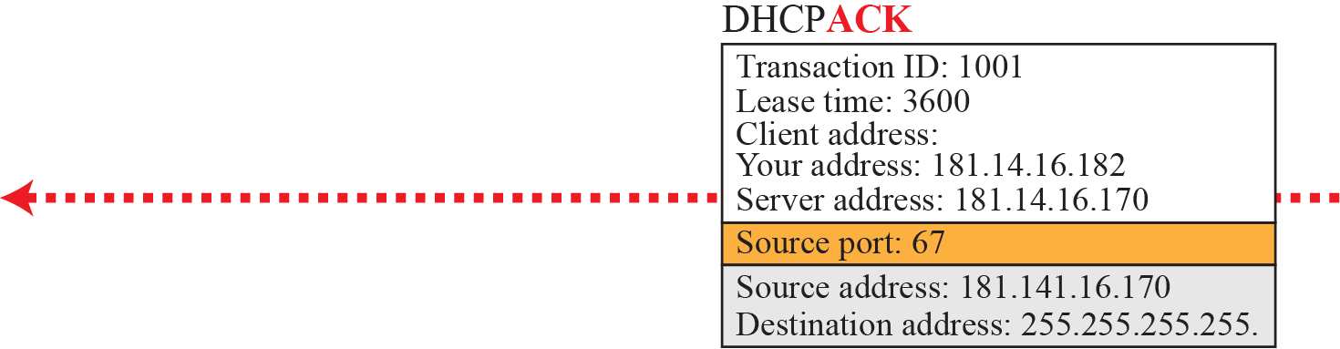
Check with Wireshark!

Slide 35
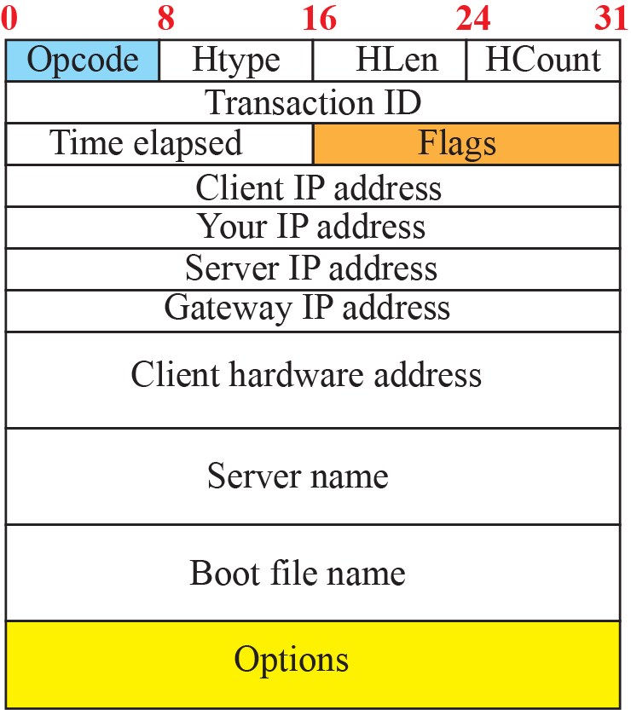
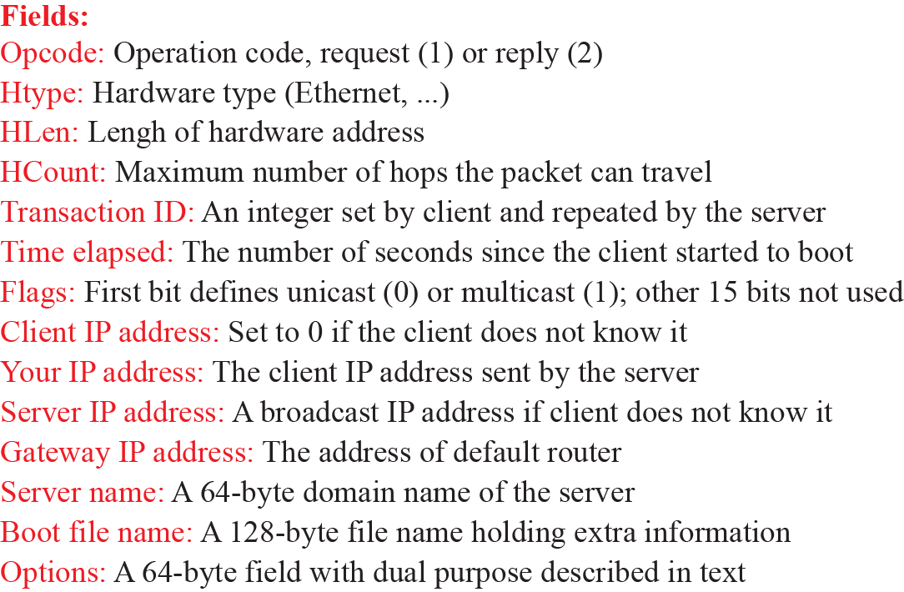
DHCP message format

Slide 36
DHCP message format
OpCode: 1 (Request), 2(Reply)
Note: DHCP message type is sent in an option
Hardware Type: 1 (for Ethernet)
Hardware address length: 6 (for Ethernet)
Hop count: set to 0 by client
Transaction ID: Integer (used to match reply to response)
Seconds: number of seconds since the client started to boot
Client IP address, Your IP address, server IP address, Gateway IP address, client hardware address, server host name, boot file name:
client fills in the information that it has, leaves rest blank

Slide 37
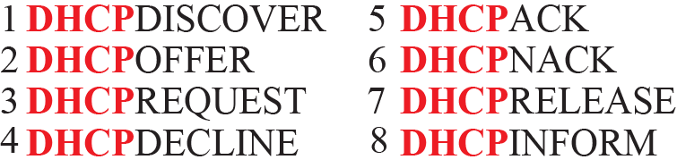
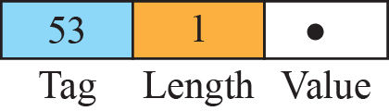
Option format
Message type is sent as an option.
Type-length-value (TLV) format

Slide 38
DHCP: more than IP addresses
DHCP is an application-layer program, using the client-server paradigm, that actually helps TCP/IP at the network layer.
DHCP can return more than just allocated IP address on subnet:
address of first-hop router for client
name and IP address of DNS sever
network mask
indicating network id & host id of the IP address

Slide 39
How a network gets IP addresses
Q: how does network get subnet part of IP addr?
A: Network gets allocated portion of its provider ISP’s address space
ISP's block 11001000 00010111 00010000 00000000 200.23.16.0/20
Organization 0 11001000 00010111 00010000 00000000 200.23.16.0/23
Organization 1 11001000 00010111 00010010 00000000 200.23.18.0/23
Organization 2 11001000 00010111 00010100 00000000 200.23.20.0/23
... ….. …. ….
Organization 7 11001000 00010111 00011110 00000000 200.23.30.0/23

Slide 40
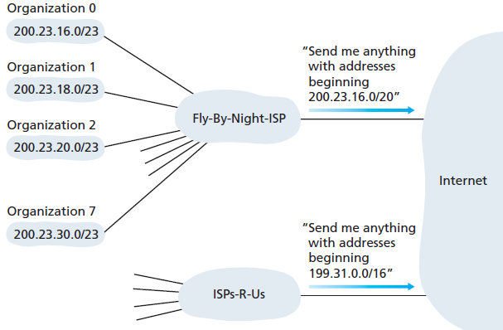
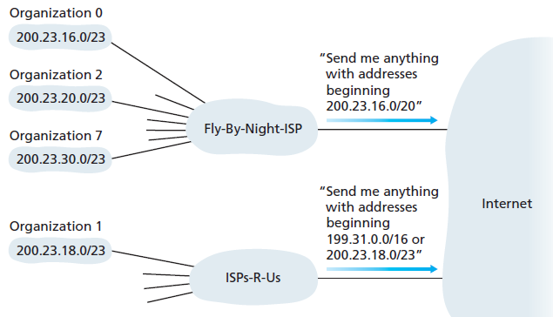
Hierarchical addressing: route aggregation
hierarchical addressing allows efficient advertisement of routing information:
ISP1
ISP1
ISP2
ISP2

Slide 41
How an ISP gets block of addresses
Q: how does an ISP get block of addresses?
A: ICANN: Internet Corporation for Assigned Names and Numbers http://www.icann.org/
allocates addresses
manages DNS
assigns domain names, resolves disputes

Slide 42
Contents
Network Layer functions
Routing algorithms overview
IP protocol overview
IP header fields
IP address configuration (DHCP)
ICMP

Slide 43
Internet Control Message Protocol (ICMP)
IP provides unreliable and connectionless delivery
Need to make efficient use of network resources
No error reporting, or correcting mechanism
Need error reporting, and in some case basic correcting methods
No management of queries
Network manager might need information about a host/router
What happens if
Router discards a packet ?
TTL expires ?
Host didn’t receive all packet’s fragments ?

Slide 44
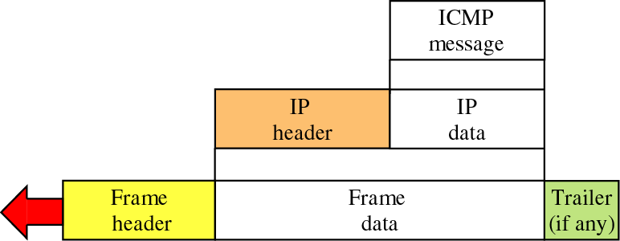
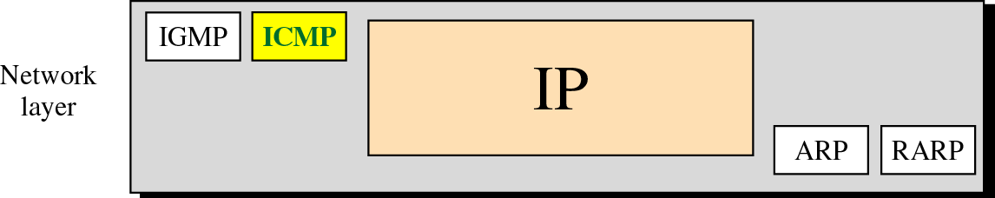
Position of ICMP in the network layer And Encapsulation
Special purpose message mechanism added to the TCP/IP protocols
Destination of an ICMP message is the ICMP software module
ICMP is a network layer protocol, but its messages are first encapsulated into IP packets.

Slide 45
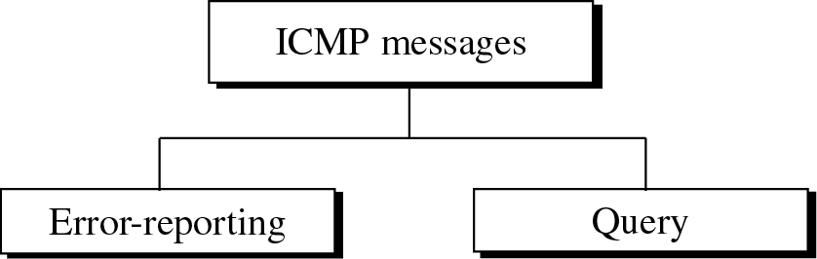
ICMP messages types

Slide 46
Destination-unreachable (Type 3)
code
ICMP destination unreachable messages with code= 2 & 3 only created by a host
All others are created by a routers
Note: Routers cannot detect all the problems that prevent the delivery of a packet.

Slide 47
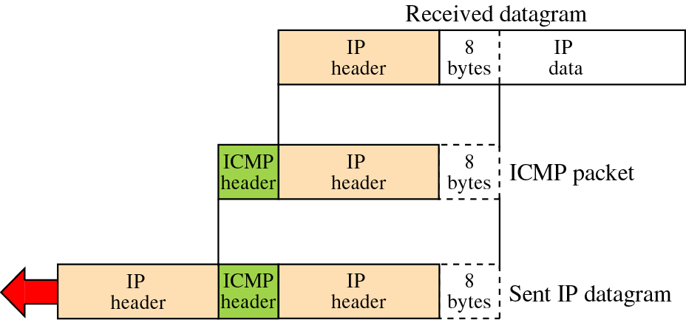
Contents of data field for error messages
In ICMP error messages
The first 8 bytes of the Transport layer header is included
Provides Information about the port numbers (TCP or UDP) and sequence number (TCP)

Slide 48
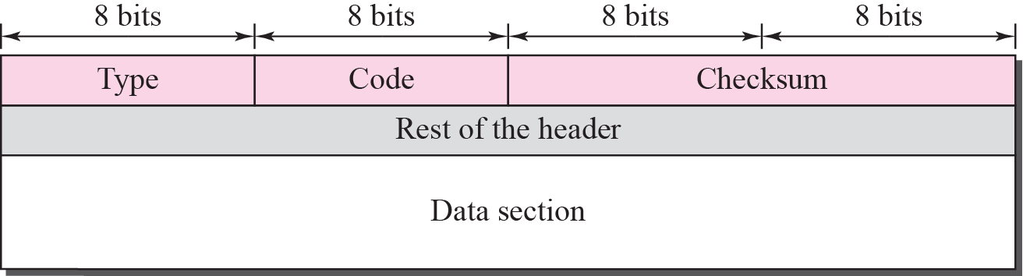
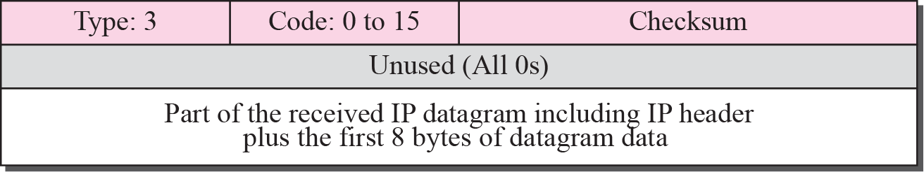
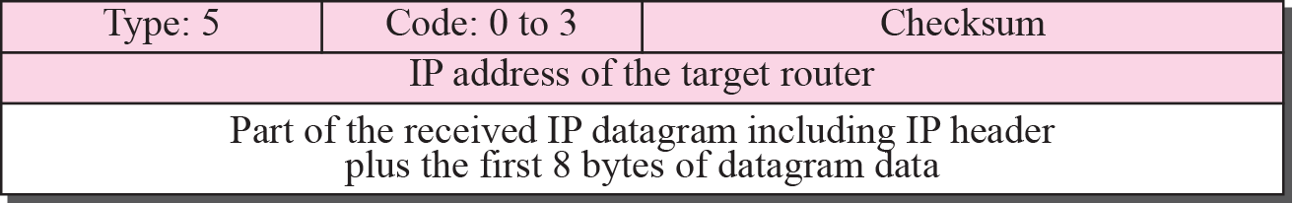
ICMP message format
Example ICMP packet (Destination-unreachable)
Example ICMP packet (Redirection message format)

Slide 49
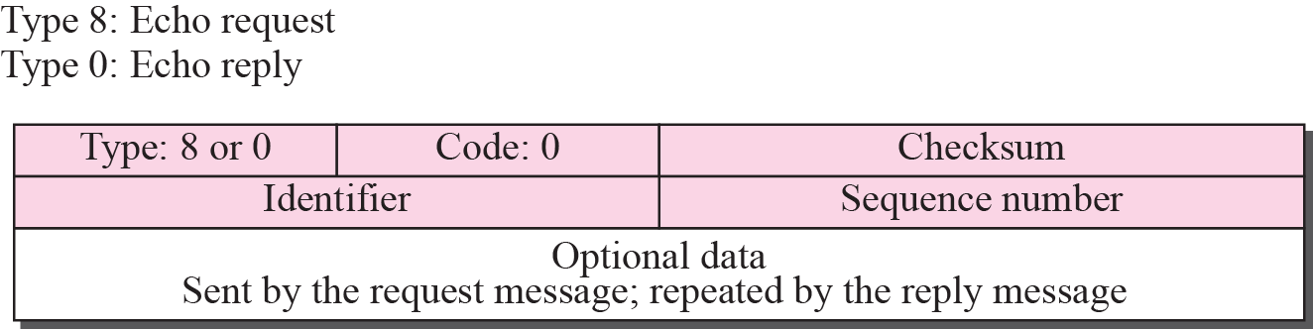
Echo-request and echo-reply
Designed for diagnosis purposes
Host or router can send a echo-request
Receivers echoes back the message with an echo-reply
Echo-request/reply used by network admin to test the reachability of a specific host
Identifier & Sequence Number are not formally used by the protocol,
Can be set to anything by the sender
Example : Ping program : a statistical tool
Does not use Transport protocols (TCP or UDP)

Slide 50
Source-quench (type =4, code =0)
IP do not provide a flow-control mechanism
Source never knows if routers or destination is congested
A source-quench message informs the source that a datagram has been discarded due to congestion in a router or the destination host
Two purposes: (1) informs the source of dropped packet (2) inform of congestion along the path
Source must slow down (quench) the sending of datagrams until the congestion is relieved.
One source-quench message should be sent to each datagram that has been discarded due to congestion
One-to-one congestion
Many-to-one congestion (congested router has no idea which source is sending datagrams faster)

Slide 51
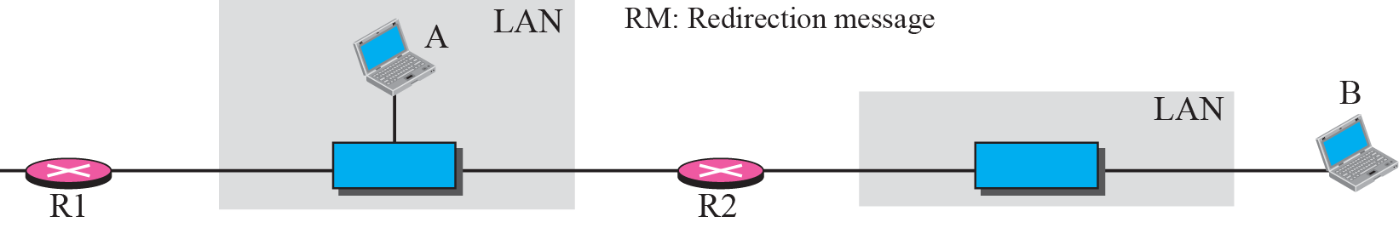
Redirection with ICMP
A host usually starts with a small routing table that is gradually augmented and updated.
One of the tools to accomplish this is the redirection message.
A redirection message is sent from a router to a host on the same local network.

Slide 52
Ping and ICMP
Ping programs uses Echo-request/reply to test reachability of a host
Identifiers : Process ID
If many ping programs are running
Sequence Number : increment for each echo-request
RTT = received_reply_time – requested_time (stored in ICMP data packet)

Slide 53
Traceroute and ICMP
source sends series of UDP segments to dest
first set has TTL =1
second set has TTL=2, etc.
unlikely port number
when n^{th} set of packets arrives to n^{th} router:
router discards packets
and sends source ICMP messages (type 11, code 0: “TTL Expired”)
ICMP messages includes name of router & IP address
when ICMP messages arrives, source records RTTs
stopping criteria:
UDP segment eventually arrives at destination host
destination returns ICMP “port unreachable” message (type 3, code 3)
source stops
Recent Windows’ “TraceRT” command uses Ping Echo requests with small TTLs. Destination returns Ping Echo-reply.
3 probes
3 probes
3 probes

Slide 54
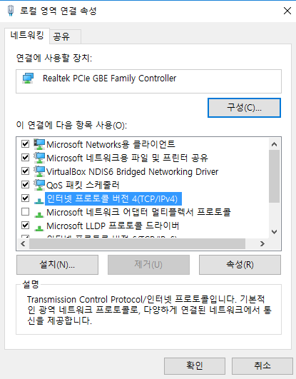
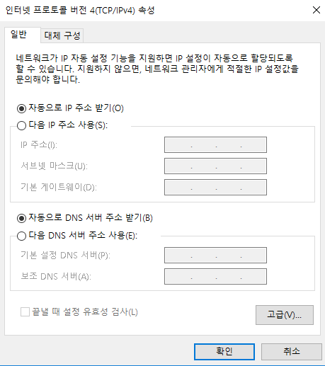
Lab 07-1. DHCP (1/3)
로컬 영역 연결 속성 → 인터넷 프로토콜 버전4 속성 → 할당된 주소 모두 copy (향후 다시 입력에 필요)
자동으로 받도록 설정되어 있는 경우는 copy 불필요

Slide 55
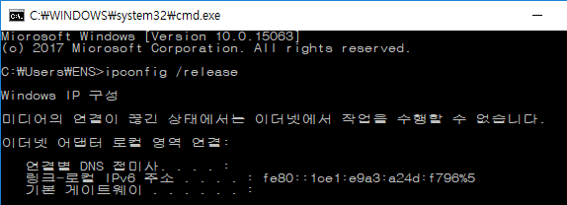
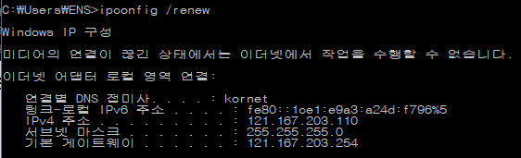
Lab. DHCP (2/3)
ipconfig /release로 IP 주소 반납
ipconfig/ renew로 DHCP 서버 접근, IP 주소 획득 ← 이 과정을 wireshark으로 capture

Slide 56
Lab. DHCP (3/3)
다음 사항을 중점적으로 관찰하고, 파악한 사항들을 기록하라.
Transport layer protocol
Port number
Physical address (내 컴퓨터와 같은지 확인)
Discover message와 Request message를 Wireshark이 어떻게 구별하는지
Transaction ID
Packet들의 IP source address와 destination address
DHCP server의 IP주소 확인
사용하도록 제시된 IP 주소

Slide 57
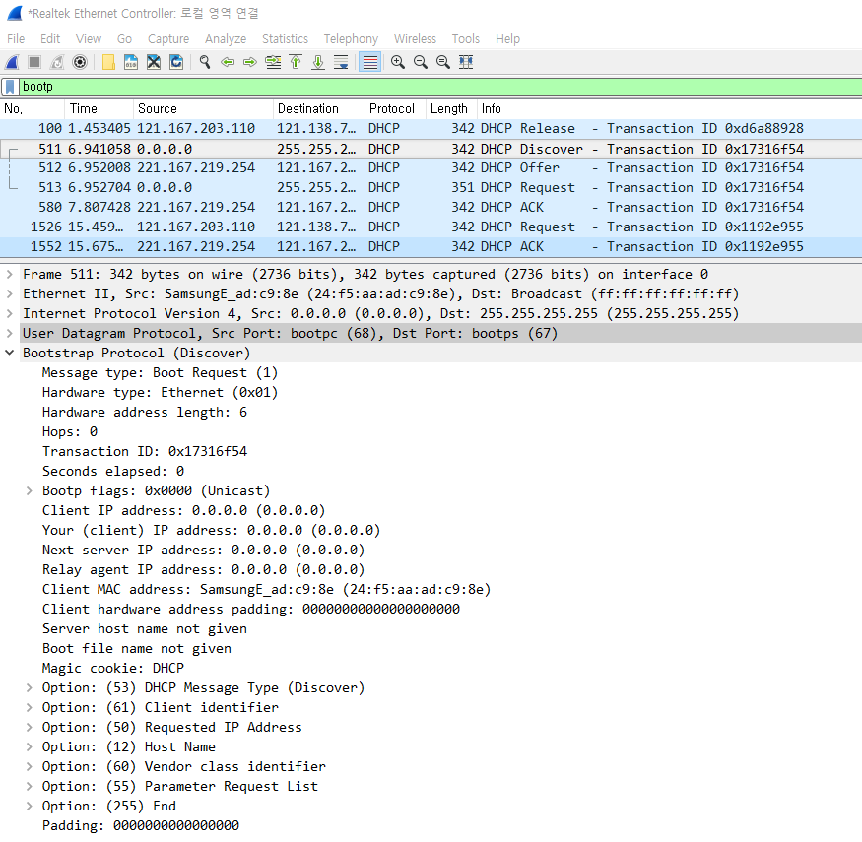

Slide 58
Lab 07-2. ICMP
Questions with Ping activities
Examine one of the ping request packets sent by your host. What are the ICMP type and code numbers? What other fields does this ICMP packet have?
Examine the corresponding ping reply packet. What are the ICMP type and code numbers? What other fields does this ICMP packet have?
Questions with Traceroute activities
Examine the ICMP echo packet in your screenshot. Is this different from the ICMP ping query packets in the first half of this lab? If yes, how so?
Examine the ICMP error packet in your screenshot. It has more fields than the ICMP echo packet. What is included in those fields?
Examine the last three ICMP packets received by the source host. How are these packets different from the ICMP error packets? Why are they different?
강의노트에서 배운 내용과 다른 점을 찾아라.

